Slide 1
BCSE307L – COMPILER DESIGN

Slide 2
Course Outcomes
Apply the skills on devising, selecting, and using tools and techniques towards compiler design
Develop language specifications using context free grammars (CFG).
Apply the ideas, the techniques, and the knowledge acquired for the purpose of developing software systems.
Constructing symbol tables and generating intermediate code.
Obtain insights on compiler optimization and code generation

Slide 3
Syllabus
Module: 1 Introduction to Compilation and Lexical Analysis 7 hours
Introduction to LLVM - Structure and Phases of a Compiler-Design Issues-Patterns Lexemes-Tokens-Attributes-Specification of Tokens-Extended Regular Expression- Regular expression to Deterministic Finite Automata (Direct method) - Lex - A Lexical Analyzer Generator
Module: 2 Syntax Analysis 8 hours
Role of Parser- Parse Tree - Elimination of Ambiguity – Top Down Parsing – Recursive Descent Parsing - LL (1) Grammars – Shift Reduce Parsers- Operator Precedence Parsing - LR Parsers, Construction of SLR Parser Tables and Parsing- CLR Parsing- LALR Parsing
Module: 3 Semantic Analysis 5 hours
Syntax Directed Definition – Evaluation Order - Applications of Syntax Directed Translation - Syntax Directed Translation Schemes - Implementation of L-attributed Syntax Directed Definition
Module: 4 Intermediate Code Generation 5 hours
Variants of Syntax trees - Three Address Code- Types – Declarations - Procedures - Assignment Statements - Translation of Expressions - Control Flow - Back Patching- Switch Case Statements.

Slide 4
Cont..
Module: 5 Code Optimization 6 hours
Loop optimizations- Principal Sources of Optimization -Introduction to Data Flow Analysis - Basic Blocks - Optimization of Basic Blocks - Peephole Optimization- The DAG Representation of Basic Blocks -Loops in Flow Graphs - Machine Independent Optimization Implementation of a naïve code generator for a virtual Machine- Security checking of virtual machine code
Module: 6 Code Generation 5 hours
Issues in the design of a code generator- Target Machine- Next-Use Information – Register Allocation and Assignment- Runtime Organization- Activation Records.
Module: 7 Parallelism 7 hours
Parallelization- Automatic Parallelization- Optimizations for Cache Locality and Vectorization- Domain Specific Languages-Compilation- Instruction Scheduling and Software Pipelining- Impact of Language Design and Architecture Evolution on Compilers Static Single Assignment
Module: 8 Contemporary Issues 2 hours

Slide 5
Finite Automata

Slide 6
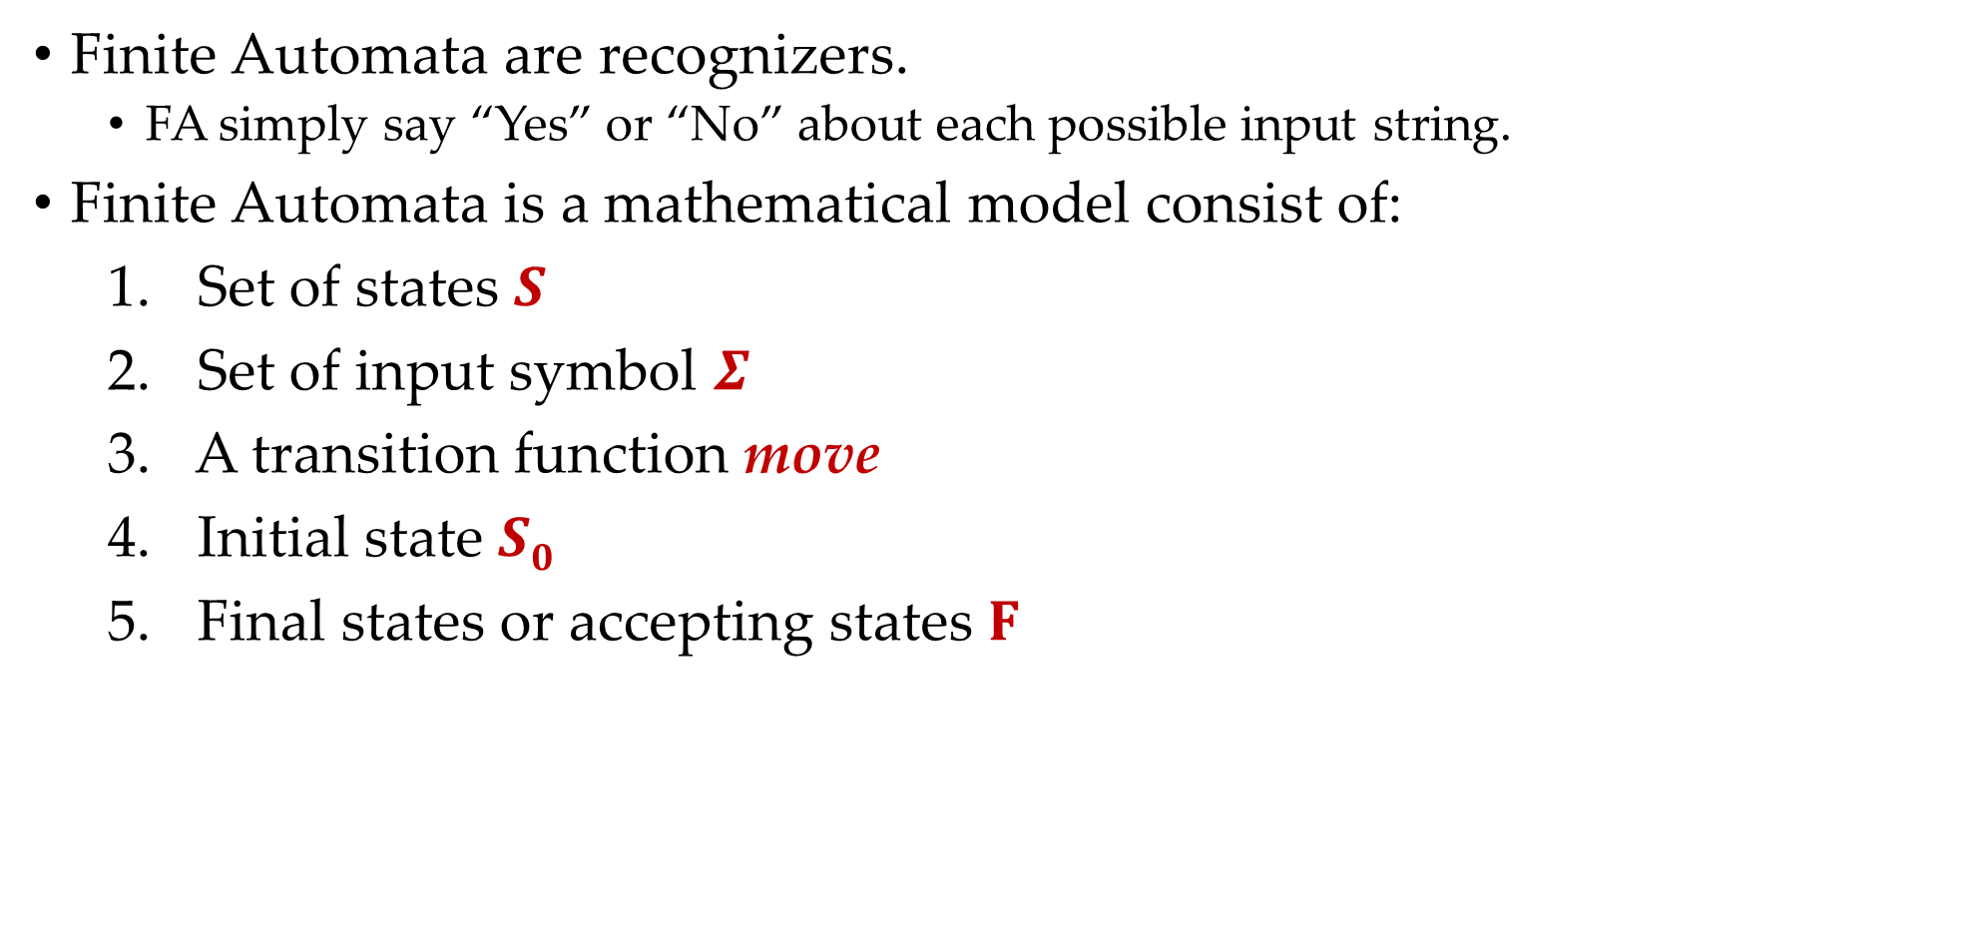
Finite Automata
Finite Automata are recognizers.
FA simply say “Yes” or “No” about each possible input string.
Finite Automata is a mathematical model consist of:
Set of states $S$
Set of input symbol $Σ$
A transition function move
Initial state $S0$
Final states or accepting states $F$

Slide 7

Types of finite automata
Types of finite automata are:
DFA
b
Deterministic finite automata (DFA): have for each state exactly one edge leaving out for each symbol.
1
a
2
b
3
b
4
a
a
b
a
NFA
DFA
Nondeterministic finite automata (NFA): There are no restrictions on the edges leaving a state. There can be several with the same symbol as label and some edges can be labeled with $ε$.
a
1
a
2
b
3
b
4
b
NFA

Slide 8








Regular expression to NFA using Thompson's rule
For $∈$ , construct the NFA
For $a$ in $Σ$, construct the NFA
For regular expression $st$
Ex: ab
start
N(s)
N(t)
$$i$$
$$f$$
start
$$i$$
𝜖
$$f$$
start
$$i$$
a
$$f$$
a
b
1
2
3

Slide 9








Regular expression to NFA using Thompson's rule
For regular expression $s|t$
Ex: (a|b)
For regular expression $s$*
Ex: a*
N(s)
𝜖
𝜖
𝜖
start
$$i$$
𝜖
N(s)
𝜖
$$f$$
start
$$i$$
$$f$$
N(t)
𝜖
𝜖
𝜖
𝜖
2
a
3
𝜖
𝜖
1
𝜖
2
$$a$$
3
𝜖
$$4$$
1
6
𝜖
4
5
𝜖
𝜖
b

Slide 10









Regular expression to NFA using Thompson's rule
a*b
b*ab
1
𝜖
2
$$a$$
3
𝜖
$$4$$
$$b$$
$$5$$
𝜖
𝜖
1
𝜖
2
$$b$$
3
𝜖
$$4$$
$$a$$
5
$$b$$
$$6$$
𝜖

Slide 11
Exercise
Convert following regular expression to NFA:
abba
bb(a)*
(a|b)*
a* | b*
a(a)*ab
aa*+ bb*
(a+b)*abb
10(0+1)*1
(a+b)*a(a+b)
(0+1)*010(0+1)*
(010+00)*(10)*
100(1)*00(0+1)*

Slide 12
Conversion from NFA to DFA using subset construction method

Slide 13
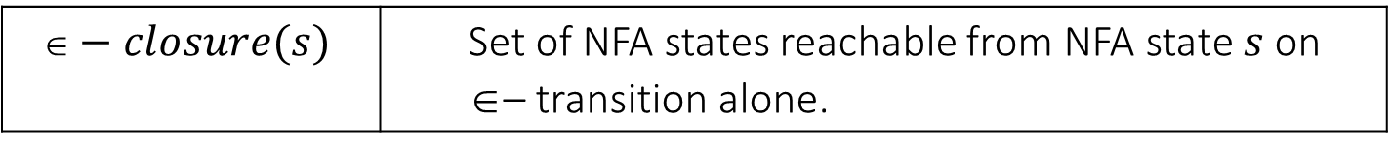

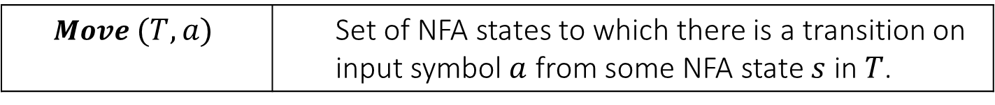
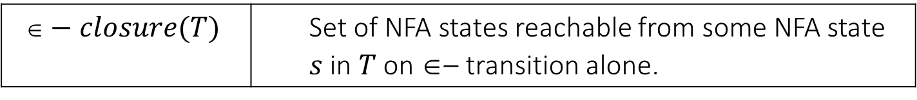
Subset construction algorithm
Input: An NFA $N$.
Output: A DFA D accepting the same language.
Method: Algorithm construct a transition table $Dtran$ for D. We use the following operation:
OPERATION | DESCRIPTION
$$−closure(s)$$ | Set of NFA states reachable from NFA state $s$ on $$– transition alone.
$$−closure(T)$$ | Set of NFA states reachable from some NFA state $s$ in $T$ on $$– transition alone.
$$Move (T,a)$$ | Set of NFA states to which there is a transition on input symbol $a$ from some NFA state $s$ in $T$.

Slide 14
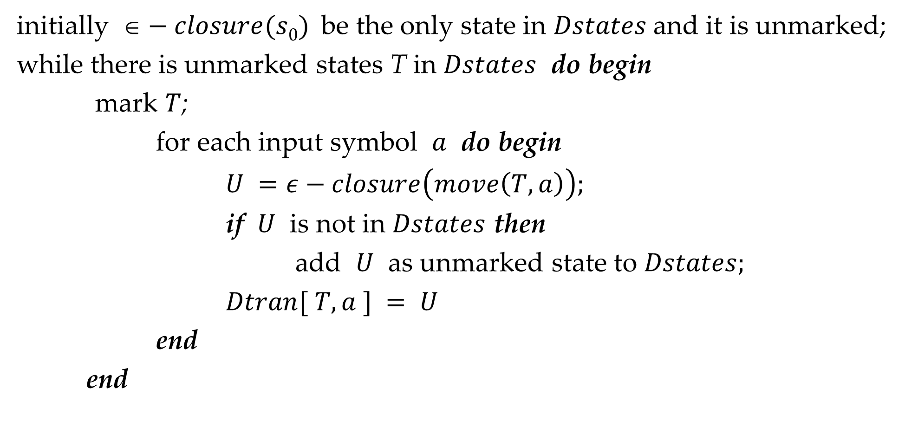
Subset construction algorithm
initially $−closure(s0)$be the only state in $Dstates$and it is unmarked;
while there is unmarked states T in $Dstates$ do begin
mark $T$;
for each input symbol $a$ do begin
$U =ε−closure\left(move\left(T, a\right)\right);$
if $U$ is not in $Dstates$ then
add $U$ as unmarked state to $Dstates;$
$Dtran[ T, a ] = U$
end
end

Slide 15
Conversion from NFA to DFA
*
(a|b)
abb
𝜖
a
2
3
𝜖
𝜖
𝜖
𝜖
7
a
8
b
9
b
10
0
1
6
𝜖
4
5
𝜖
b
𝜖

Slide 16
Conversion from NFA to DFA
𝜖
a
2
3
𝜖
𝜖
𝜖
𝜖
7
a
8
b
9
b
10
0
1
6
𝜖
4
5
𝜖
b
𝜖
𝜖- Closure(0)=
{0, 1, 7, 2, 4}
= {0,1,2,4,7}
---- A

Slide 17
Conversion from NFA to DFA
𝜖
a
States | a | b
2
3
𝜖
𝜖
A = {0,1,2,4,7} | B
𝜖
𝜖
7
a
8
b
9
b
10
0
1
6
B = {1,2,3,4,6,7,8}
𝜖
4
5
𝜖
b
𝜖
A= {0, 1, 2, 4, 7}
Move(A,a)
= {3,8}
𝜖- Closure(Move(A,a))
= {3, 6, 7, 1, 2, 4, 8}
= {1,2,3,4,6,7,8}
---- B

Slide 18
Conversion from NFA to DFA
𝜖
a
States | a | b
2
3
𝜖
𝜖
A = {0,1,2,4,7} | B | C
𝜖
𝜖
7
a
8
b
9
b
10
0
1
6
B = {1,2,3,4,6,7,8}
C = {1,2,4,5,6,7}
𝜖
4
5
𝜖
b
𝜖
A= {0, 1, 2, 4, 7}
Move(A,b) =
{5}
𝜖- Closure(Move(A,b)) =
{5, 6, 7, 1, 2, 4}
= {1,2,4,5,6,7}
---- C

Slide 19
Conversion from NFA to DFA
𝜖
a
States | a | b
2
3
𝜖
𝜖
A = {0,1,2,4,7} | B | C
𝜖
𝜖
7
a
8
b
9
b
10
0
1
6
B = {1,2,3,4,6,7,8} | B
C = {1,2,4,5,6,7}
𝜖
4
5
𝜖
b
𝜖
B = {1, 2, 3, 4, 6, 7, 8}
Move(B,a)
= {3,8}
𝜖- Closure(Move(B,a))
= {3, 6, 7, 1, 2, 4, 8}
= {1,2,3,4,6,7,8}
---- B

Slide 20
Conversion from NFA to DFA
𝜖
a
States | a | b
2
3
𝜖
𝜖
A = {0,1,2,4,7} | B | C
𝜖
𝜖
7
a
8
b
9
b
10
0
1
6
B = {1,2,3,4,6,7,8} | B | D
C = {1,2,4,5,6,7}
𝜖
4
5
𝜖
D = {1,2,4,5,6,7,9}
b
𝜖
B= {1, 2, 3, 4, 6, 7, 8}
Move(B,b)
= {5,9}
𝜖- Closure(Move(B,b))
= {5, 6, 7, 1, 2, 4, 9}
= {1,2,4,5,6,7,9}
---- D

Slide 21
Conversion from NFA to DFA
𝜖
a
States | a | b
2
3
𝜖
𝜖
A = {0,1,2,4,7} | B | C
𝜖
𝜖
7
a
8
b
9
b
10
0
1
6
B = {1,2,3,4,6,7,8} | B | D
C = {1,2,4,5,6,7} | B
𝜖
4
5
𝜖
D = {1,2,4,5,6,7,9}
b
𝜖
C= {1, 2, 4, 5, 6 ,7}
Move(C,a)
= {3,8}
𝜖- Closure(Move(C,a))
= {3, 6, 7, 1, 2, 4, 8}
= {1,2,3,4,6,7,8}
---- B

Slide 22
Conversion from NFA to DFA
𝜖
a
States | a | b
2
3
𝜖
𝜖
A = {0,1,2,4,7} | B | C
𝜖
𝜖
7
a
8
b
9
b
10
0
1
6
B = {1,2,3,4,6,7,8} | B | D
C = {1,2,4,5,6,7} | B | C
𝜖
4
5
𝜖
D = {1,2,4,5,6,7,9}
b
𝜖
C= {1, 2, 4, 5, 6, 7}
Move(C,b) =
{5}
𝜖- Closure(Move(C,b))=
{5, 6, 7, 1, 2, 4}
= {1,2,4,5,6,7}
---- C

Slide 23
Conversion from NFA to DFA
𝜖
a
States | a | b
2
3
𝜖
𝜖
A = {0,1,2,4,7} | B | C
𝜖
𝜖
7
a
8
b
9
b
10
0
1
6
B = {1,2,3,4,6,7,8} | B | D
C = {1,2,4,5,6,7} | B | C
𝜖
4
5
𝜖
D = {1,2,4,5,6,7,9} | B
b
𝜖
D= {1, 2, 4, 5, 6, 7, 9}
Move(D,a)
= {3,8}
𝜖- Closure(Move(D,a))
= {3, 6, 7, 1, 2, 4, 8}
= {1,2,3,4,6,7,8}
---- B

Slide 24
Conversion from NFA to DFA
𝜖
a
States | a | b
2
3
𝜖
𝜖
A = {0,1,2,4,7} | B | C
𝜖
𝜖
7
a
8
b
9
b
10
0
1
6
B = {1,2,3,4,6,7,8} | B | D
C = {1,2,4,5,6,7} | B | C
𝜖
4
5
𝜖
D = {1,2,4,5,6,7,9} | B | E
b
E = {1,2,4,5,6,7,10}
𝜖
D= {1, 2, 4, 5, 6, 7, 9}
Move(D,b)
= {5,10}
𝜖- Closure(Move(D,b))
= {5, 6, 7, 1, 2, 4, 10}
= {1,2,4,5,6,7,10}
---- E

Slide 25
Conversion from NFA to DFA
𝜖
a
States | a | b
2
3
𝜖
𝜖
A = {0,1,2,4,7} | B | C
𝜖
𝜖
7
a
8
b
9
b
10
0
1
6
B = {1,2,3,4,6,7,8} | B | D
C = {1,2,4,5,6,7} | B | C
𝜖
4
5
𝜖
D = {1,2,4,5,6,7,9} | B | E
b
E = {1,2,4,5,6,7,10} | B
𝜖
E= {1, 2, 4, 5, 6, 7, 10}
Move(E,a)
= {3,8}
𝜖- Closure(Move(E,a))
= {3, 6, 7, 1, 2, 4, 8}
= {1,2,3,4,6,7,8}
---- B

Slide 26
Conversion from NFA to DFA
𝜖
a
States | a | b
2
3
𝜖
𝜖
A = {0,1,2,4,7} | B | C
𝜖
𝜖
7
a
8
b
9
b
10
0
1
6
B = {1,2,3,4,6,7,8} | B | D
C = {1,2,4,5,6,7} | B | C
𝜖
4
5
𝜖
D = {1,2,4,5,6,7,9} | B | E
b
E = {1,2,4,5,6,7,10} | B | C
𝜖
E= {1, 2, 4, 5, 6, 7, 10}
Move(E,b)=
{5}
𝜖- Closure(Move(E,b))=
{5,6,7,1,2,4}
= {1,2,4,5,6,7}
---- C

Slide 27





Conversion from NFA to DFA
a
b
States | a | b
$$B$$
$$D$$
a
A = {0,1,2,4,7} | B | C
a
B = {1,2,3,4,6,7,8} | B | D
$$A$$
a
a
b
C = {1,2,4,5,6,7} | B | C
D = {1,2,4,5,6,7,9} | B | E
b
$$C$$
$$E$$
E = {1,2,4,5,6,7,10} | B | C
b
Transition Table
b
Note:
Accepting state in NFA is 10
10 is element of E
So, E is acceptance state in DFA
DFA

Slide 28
Exercise
Convert following regular expression to DFA using subset construction method:
(a+b)*a(a+b)
(a+b)*ab*a

Slide 29
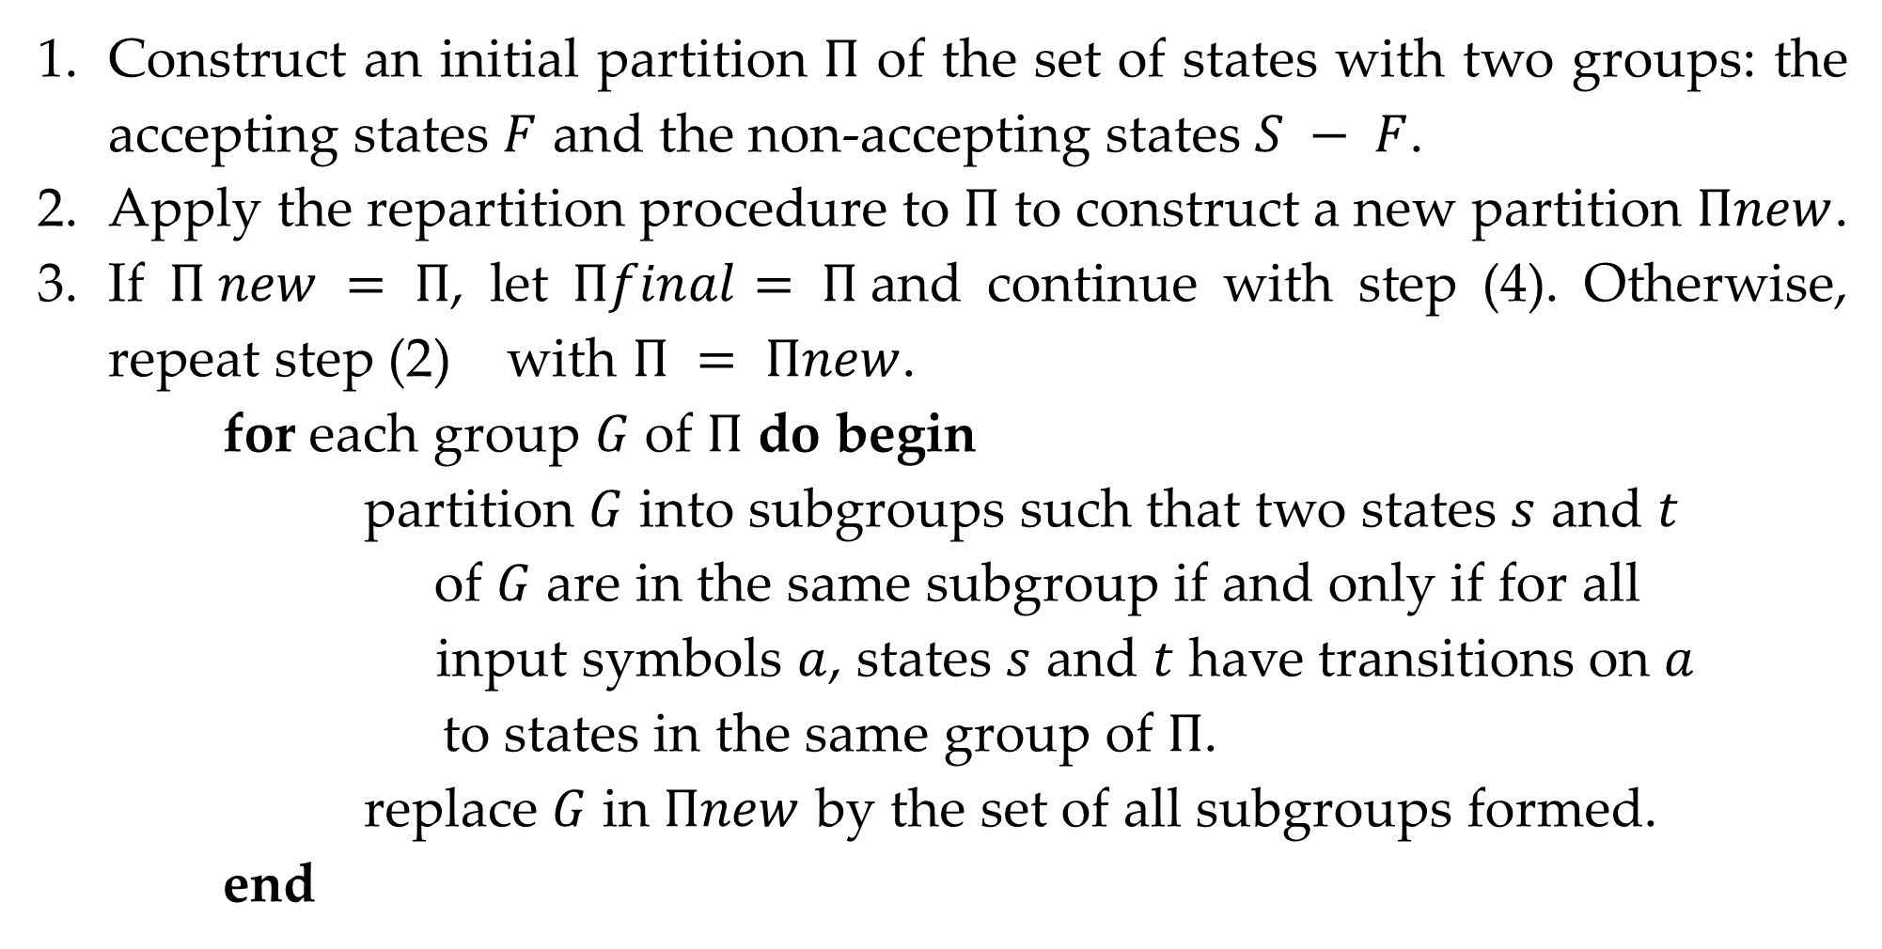
DFA optimization
Construct an initial partition $Π$ of the set of states with two groups: the accepting states $F$ and the non-accepting states $S − F$.
Apply the repartition procedure to $Π$ to construct a new partition $Πnew$.
If $Π new = Π$, let $Πfinal= Π$and continue with step (4). Otherwise, repeat step (2) with $Π = Πnew$.
for each group $G$ of $Π$ do begin
partition $G$ into subgroups such that two states $s$ and $t$
of $G$ are in the same subgroup if and only if for all
input symbols $a$, states $s$ and $t$ have transitions on $a$
to states in the same group of $Π$.
replace $G$ in $Πnew$ by the set of all subgroups formed.
end

Slide 30
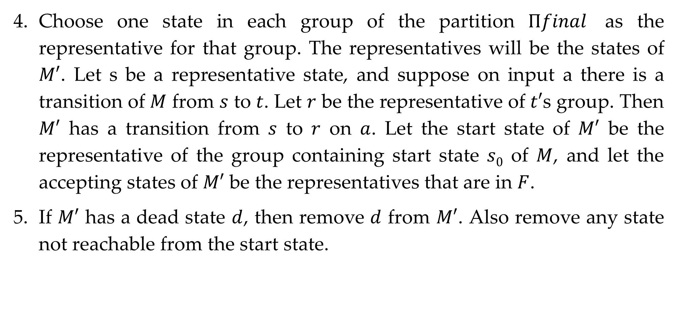
DFA optimization
Choose one state in each group of the partition $Πfinal$ as the representative for that group. The representatives will be the states of $M′$. Let s be a representative state, and suppose on input a there is a transition of $M$ from $s$ to $t$. Let $r$ be the representative of $t′$s group. Then $M′$ has a transition from $s$ to $r$ on $a$. Let the start state of $M′$ be the representative of the group containing start state $s0$ of $M$, and let the accepting states of $M′$ be the representatives that are in $F$.
If $M′$ has a dead state $d$, then remove $d$ from $M′$. Also remove any state not reachable from the start state.

Slide 31

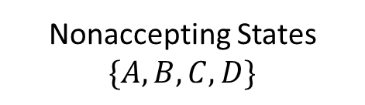


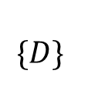
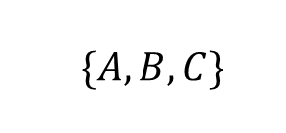
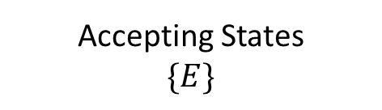
DFA optimization
States | a | b
$$\{A,B,C,D,E\}$$
A | B | C
Nonaccepting States $\{A,B,C,D\}$
Accepting States
$$\{E\}$$
B | B | D
C | B | C
D | B | E
$\{A,B,C\}$
$$\{D\}$$
E | B | C
$\{A,C\}$
$\{B\}$
States | a | b
A | B | A
B | B | D
Now no more splitting is possible.
If we chose A as the representative for group (AC), then we obtain reduced transition table
D | B | E
E | B | A
Optimized Transition Table

